Slide 1
Pixel 3 GMS App Investigations
Part 4: Google Photos
Notes:
https://digitalcorpora.s3.amazonaws.com/corpora/mobile/android_10/Non-Cellebrite%20Extraction/Pixel%203.zip

Slide 2
What is Google Photos ?

Slide 3
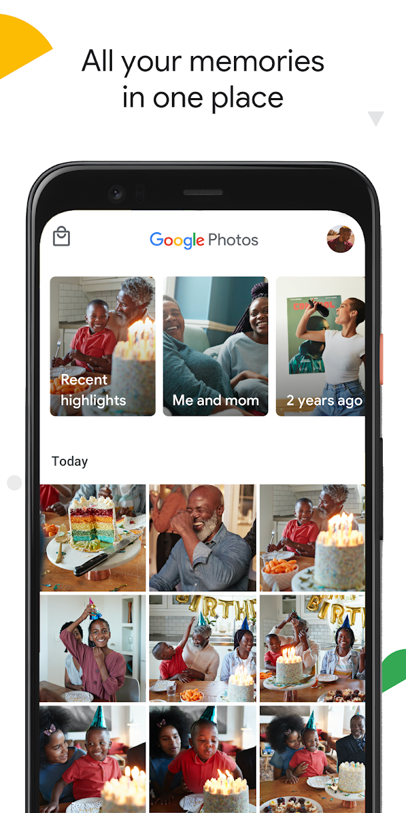
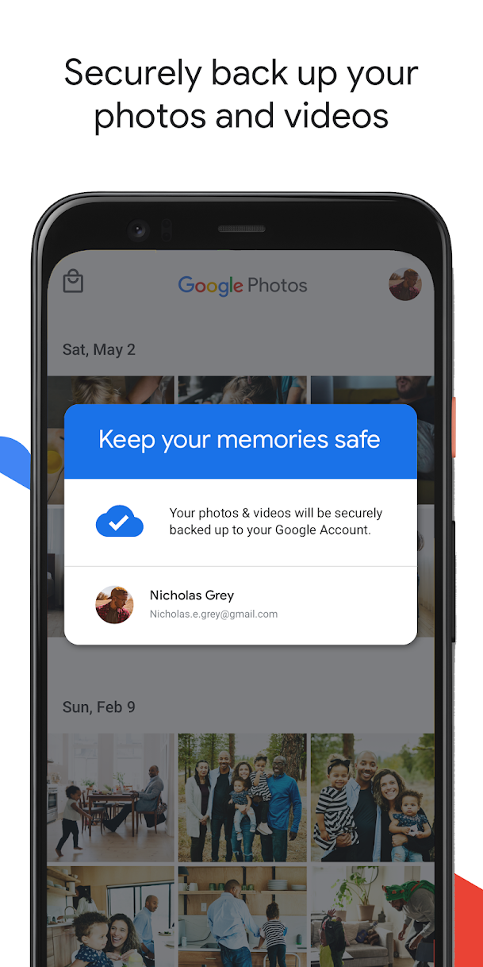
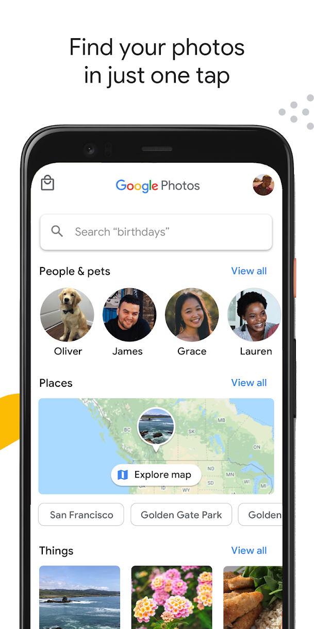
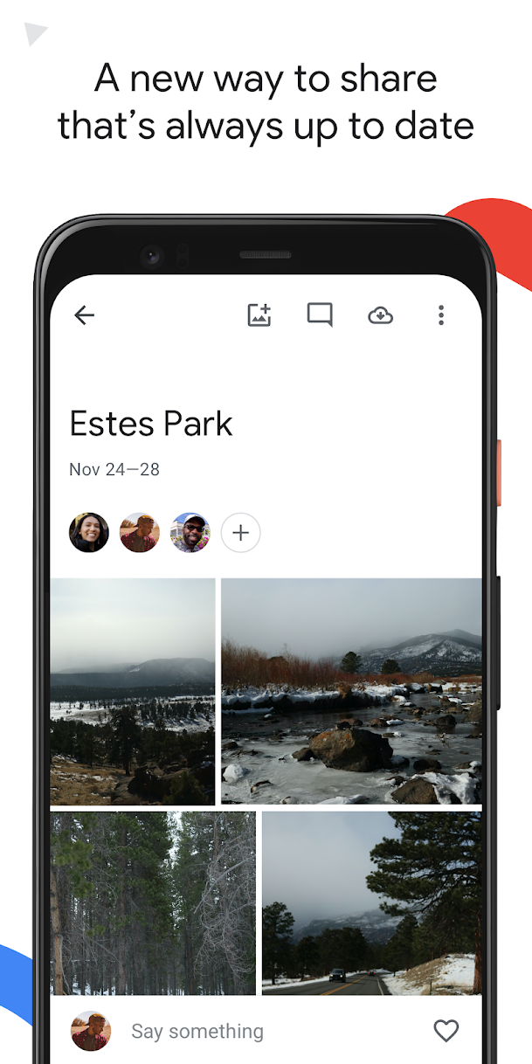
A cloud-based photo and video management app

Slide 4
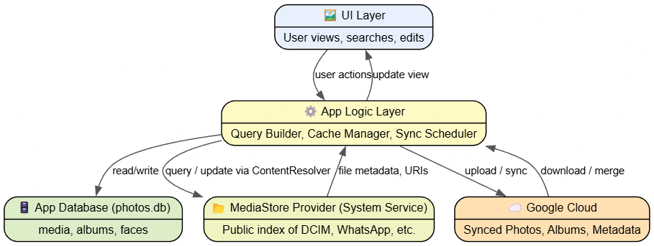
Key components of Google Photos
relation between Google Photos functions, app logic, system service, and database
Component | Role
MediaStore Provider (System) | Master index of all on-device photos/videos, accessible to all apps.
App Logic Layer (Google Photos) | Reads and synchronizes MediaStore entries into its own internal metadata tables.
Local Database (photos.db) | App-specific metadata store for caching, search indexing, and sync tracking.
Cloud Sync Layer (MediaSyncService) | Uploads files referenced from MediaStore to Google Cloud.
Notes:
digraph PhotosSystemIntegration {
rankdir=TB;
node [shape=record, style="rounded,filled", fontname="Helvetica", fontsize=11];
edge [fontname="Helvetica", fontsize=10, arrowsize=0.8, color="#555555"];
UI [label="{🖼️ UI Layer|User views, searches, edits}", fillcolor="#e8f0fe"];
Logic [label="{⚙️ App Logic Layer|Query Builder, Cache Manager, Sync Scheduler}", fillcolor="#fff9c4"];
DB [label="{🗄️ App Database (photos.db)|media, albums, faces}", fillcolor="#dcedc8"];
MediaStore [label="{📂 MediaStore Provider (System Service)|Public index of DCIM, WhatsApp, etc.}", fillcolor="#f0f4c3"];
Cloud [label="{☁️ Google Cloud|Synced Photos, Albums, Metadata}", fillcolor="#ffe0b2"];
UI -> Logic [label="user actions"];
Logic -> DB [label="read/write"];
Logic -> MediaStore [label="query / update via ContentResolver"];
MediaStore -> Logic [label="file metadata, URIs"];
Logic -> Cloud [label="upload / sync"];
Cloud -> Logic [label="download / merge"];
Logic -> UI [label="update view"];
}

Slide 5
Google Photos manages all discoverable local media on the device
Category | Managed by Google Photos? | Where stored
Camera captures (Digital Camera Images.) | ✅ Always | /DCIM/Camera/
Screenshots | ✅ Often | /Pictures/Screenshots/
Downloads / received images | ✅ If indexed by MediaStore | /Download/, /WhatsApp/Images/, /Telegram/
Edited or saved photos | ✅ If not hidden (.nomedia) | /Pictures/Edited/, /DCIM/.thumbnails/
App-specific images (e.g. Instagram) | ⚙️ Sometimes (if visible to MediaStore) | /Android/media/com.instagram.android/...
Hidden or private folders | ❌ No | Directories with .nomedia or not indexed by MediaStore
MediaStore is Android’s system-managed database and API layer that provides a unified way for apps to access, organize, and share media files—such as photos, videos, and audio—stored on the device or in shared storage.

Slide 6
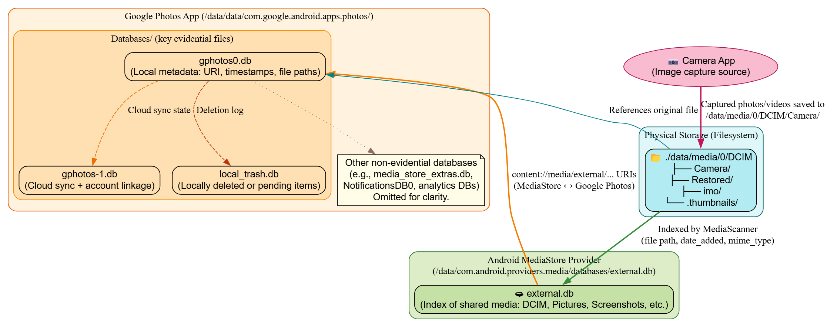
From Camera captures to picture management
Notes:
digraph GooglePhotosForensics {
rankdir=TB;
node [shape=box, style="rounded,filled", fontname="Helvetica"];
// === Physical Storage Layer ===
subgraph cluster_physical {
label="Physical Storage (Filesystem)";
color="#006064"; fillcolor="#e0f7fa"; style="filled,rounded";
DCIM [label="📂 ./data/media/0/DCIM\n├── Camera/\n├── Restored/\n├── imo/\n└── .thumbnails/",
fillcolor="#b2ebf2"];
}
// === MediaStore Layer ===
subgraph cluster_mediastore {
label="Android MediaStore Provider\n(/data/com.android.providers.media/databases/external.db)";
color="#2e7d32"; fillcolor="#dcedc8"; style="filled,rounded";
external [label="🗃 external.db\n(Index of shared media: DCIM, Pictures, Screenshots, etc.)",
fillcolor="#c5e1a5"];
}
// === Google Photos App Layer ===
subgraph cluster_photos {
label="Google Photos App (/data/data/com.google.android.apps.photos/)";
color="#e65100"; fillcolor="#fff3e0"; style="filled,rounded";
subgraph cluster_databases {
label="Databases/ (key evidential files)";
color="#fb8c00"; fillcolor="#ffe0b2"; style="filled,rounded";
gphotos0 [label="gphotos0.db\n(Local metadata: URI, timestamps, file paths)", fillcolor="#ffe0b2"];
gphotos1 [label="gphotos-1.db\n(Cloud sync + account linkage)", fillcolor="#ffe0b2"];
trashdb [label="local_trash.db\n(Locally deleted or pending items)", fillcolor="#ffe0b2"];
}
note [shape=note, fillcolor="#fffde7",
label="Other non-evidential databases\n(e.g., media_store_extras.db,\nNotificationsDB0, analytics DBs)\nOmitted for clarity."];
}
// === Camera Source Node ===
camera [label="📷 Camera App\n(Image capture source)",
shape=ellipse, fillcolor="#f8bbd0", color="#ad1457", style="filled,rounded"];
camera -> DCIM [label="Captured photos/videos saved to\n/data/media/0/DCIM/Camera/",
color="#c2185b", penwidth=2];
// === Relationships ===
DCIM -> external [label="Indexed by MediaScanner\n(file path, date_added, mime_type)",
color="#388e3c", penwidth=2];
external -> gphotos0 [label="content://media/external/... URIs\n(MediaStore ↔ Google Photos)",
color="#f57c00", penwidth=2];
gphotos0 -> gphotos1 [label="Cloud sync state", color="#ef6c00", style=dashed];
gphotos0 -> trashdb [label="Deletion log", color="#bf360c", style=dashed];
gphotos0 -> DCIM [label="References original file", color="#00838f", dir=back];
gphotos0 -> note [style=dotted, color="#8d6e63"];
}

Slide 7
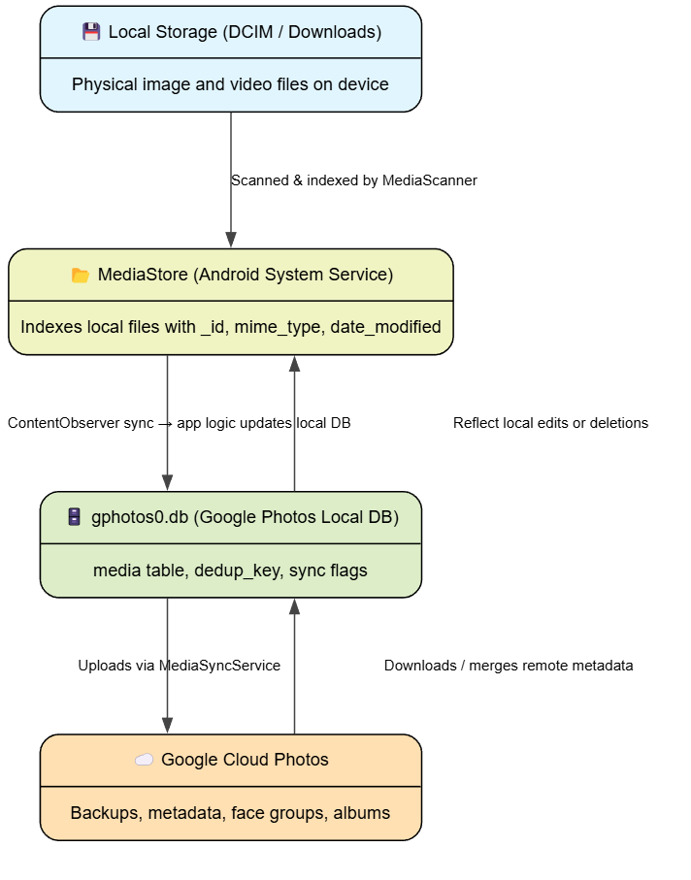
Event-based synchronization
Camera app takes photos
Saves photos in a physical location
Google Photos does not crawl the filesystem directly.
MediaStore service
It queries through the system API
It indexes all user-visible media in external.db, when
boot completed, file created or deleted, mount or unmount of external storage, app requests
It broadcasts a message
Google Photos received broadcast messages
queries MediaStore for that file, and
inserts or updates a corresponding entry in its own media table.

Slide 8
Fields used in photo databases
Field | Meaning
in_camera_folder | 1 = came from /DCIM/Camera/
in_primary_storage | 1 = from /data/media/0 (integral mounted storage, not SD card)
has_local | 1 = As long as the file is visible to Android’s MediaStore provider, Google Photos considers it local, including SD card, excluding Cloud-only photo
type | may show MIME (e.g. image/jpeg, video/mp4)

Slide 9
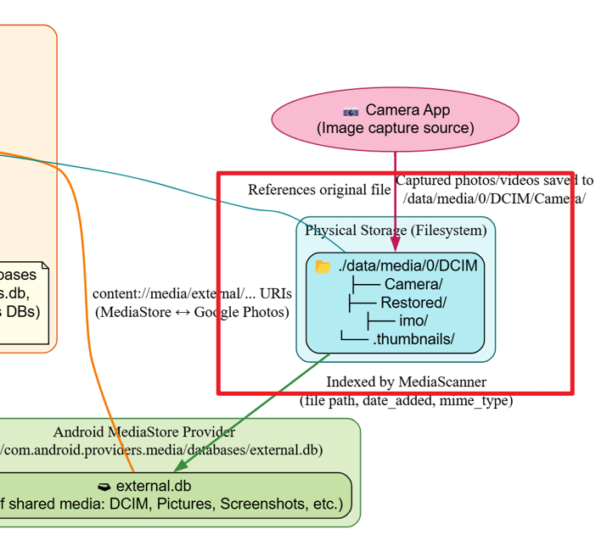
Physical storage
Real image evidence

Slide 10
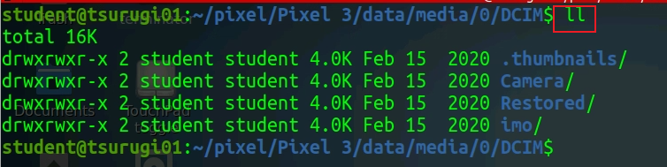
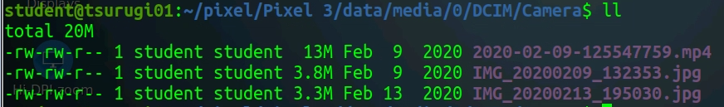
Folder | Meaning | Evidence value
Camera/ | Locally captured photos/videos | Primary originals
Restored/ | Recovered or cloud-restored images | Proves device restore or sync
imo/ | Third-party app media | Source attribution
.thumbnails/ | Cached previews | Recovery evidence for deleted items

Slide 11
Sample questions
What photos are saved? location and timestamps
What location has the most photos?
Did a suspect receive the photos from someone?
Can we deduce the suspect's relation to people in the photos/videos?
Are there any deleted photos?

Slide 12
Google Photo Directory

Slide 13
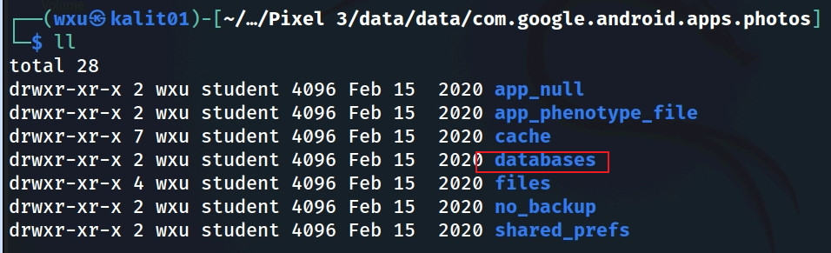
Show Google Photos package structure
Notes:
Cmd: tree 'Pixel 3/data/data/com.google.android.apps.photos' -L 1

Slide 14
Google Photo Databases

Slide 15
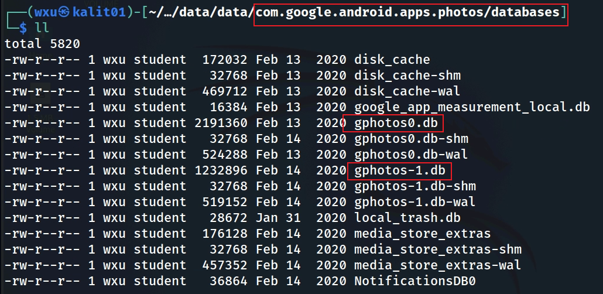
Valuable databases
photosx.db: Image metadata storage
disk_cache: which are temporary storage for app performance
local_trash.db: which tracks deleted item
NotificationsDB0: which logs app notifications
Notes:
Cmd: tree 'Pixel 3/data/data/com.google.android.apps.photos/databases'

Slide 16
gphotos_0.db

Slide 17
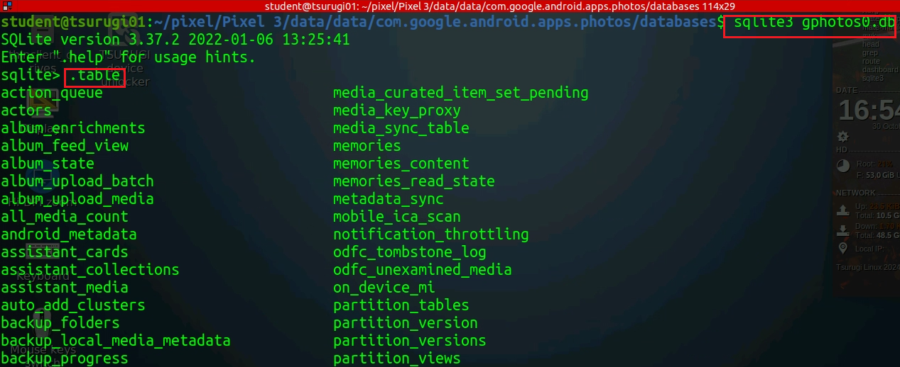

Slide 18
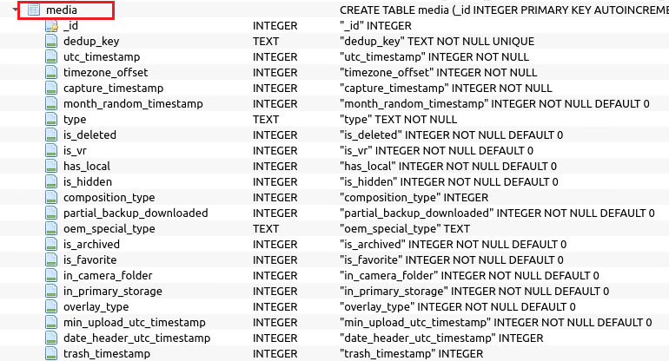

Slide 19
Column | Description | Forensic relevance
_id | Internal unique media ID (primary key) | Used to link with other tables like albums_media, face, thumbnails, etc.
dedup_key | Unique hash or fingerprint of content (EXIF + capture time) | Identifies duplicates or same file synced multiple times. Important for proving identical photos across devices/accounts.
utc_timestamp | UTC time the media was created or first seen | Core timestamp for photo capture timeline (convert from epoch).
timezone_offset | Offset in seconds from UTC (e.g., -18000 = UTC-5) | Combine with utc_timestamp to compute local time.
capture_timestamp | Actual time photo/video was captured | Often matches EXIF “Date/Time Original”; critical for timeline reconstruction.
month_random_timestamp | Randomized bucket timestamp (for UI grouping) | Typically not evidentially important.
type | MIME or media type (image/jpeg, video/mp4, etc.) | Identifies photo vs video.
is_deleted | 1 if photo deleted locally or moved to trash (controlled by Google Photos) | Detects deletions — cross-verify with trash_timestamp.
is_vr | VR or 360° content flag | Rare; identifies panoramic or VR media.
has_local | 1 if physical file still exists on device (controlled by MediaStore + Google Photos uses MediaStore scanning results) | 🔥 Critical for verifying whether the file remains on disk.
is_hidden | 1 if hidden from gallery view | Indicates deliberate concealment (potential evidential value).
composition_type | Integer representing multi-frame, burst, or motion photos | Can reveal motion photo metadata (Pixel Live Photos).
partial_backup_downloaded | Whether partially downloaded from cloud | Shows partial restoration or preview state.
oem_special_type | Manufacturer-defined content type (e.g., portrait, night mode) | Context about photo origin.
is_archived | 1 if user archived the item | Hides from main gallery — relevant for intent to conceal.
is_favorite | 1 if user “starred” or favorited the item | Indicates intentional preservation.
in_camera_folder | 1 if stored in /DCIM/Camera/ | Confirms photo was captured with device camera.
in_primary_storage | 1 if located in main user storage (/data/media/0/) | Differentiates between SD card or internal memory.
overlay_type | Used for editing overlays (filters, markup, etc.) | May indicate media was modified.
min_upload_utc_timestamp | Earliest upload time to Google Photos cloud | Cross-check with gphotos-1.db for cloud sync timeline.
date_header_utc_timestamp | Display timestamp used for grouping | UI-only, low evidential value.
trash_timestamp | When moved to Trash (epoch UTC) | 🔥 Evidence of deletion activity. Combine with is_deleted=1.

Slide 20
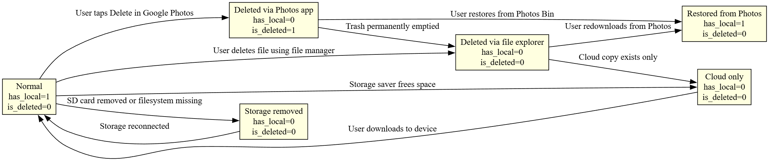
Scenario | has_local | is_deleted | Meaning
Normal photo | 1 | 0 | Exists on device
Deleted via Photos | 0 | 1 | Moved to Photos Bin
Deleted via file explorer | 0 | 0 | Missing locally, not trashed
Cloud-only item | 0 | 0 | Removes the local copy but keeps the cloud copy.
Restored from trash | 1 | 0 | On device again

Slide 21
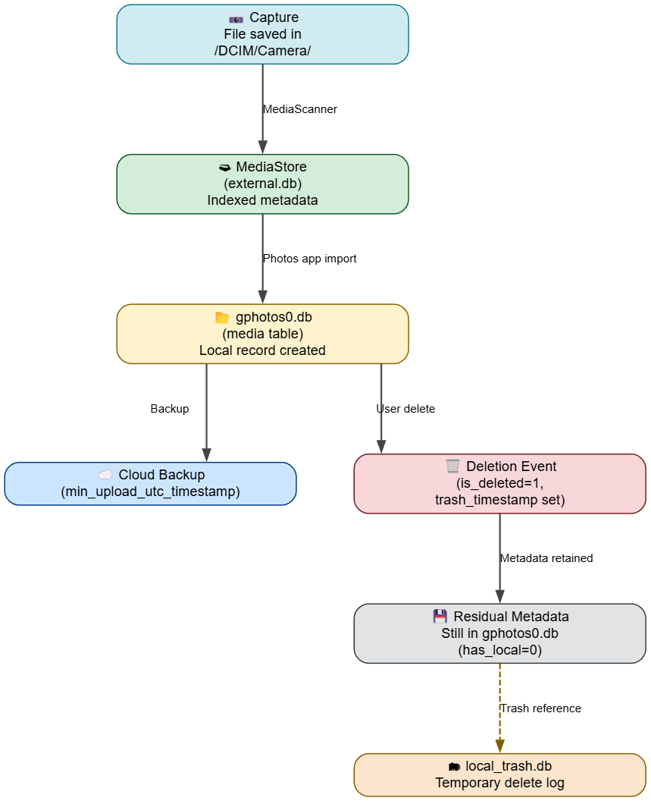
Understanding Google Photos’ persistence of deleted evidence
Even after a photo or video is deleted from /data/media/0/DCIM/Camera/, the app continues tracking it in gphotos0.db, and that persistence is one of the most valuable forensic artifacts.

Slide 22
1. Separation between file system and app metadata
When a user deletes a photo via the Google Photos app, two distinct things happen:
Layer | Action | Persistence
Filesystem (DCIM) | The physical JPG/MP4 is deleted (or moved to app’s trash cache) | The file itself may disappear from /DCIM/Camera/
App database (gphotos0.db) | The metadata row in media table is not deleted — it’s updated with new flags (is_deleted=1, trash_timestamp set, has_local toggled) | ✅ Metadata persists until app cache is cleared
That’s why you can still see metadata for 20–100 media items long after they’ve been removed from /DCIM/.

Slide 23
2. What exactly happens inside gphotos0.db
Let’s look at the lifecycle of a file originally in /DCIM/Camera/IMG_20200209_132353.jpg:
Event | Field changes in media table | Notes
Capture or first scan | has_local=1, is_deleted=0, in_camera_folder=1, trash_timestamp=NULL | File exists locally
User deletes via Photos app | is_deleted=1, trash_timestamp = current epoch time, has_local may remain 1 (until rescan by mediastore service) | Record marked as trashed
App syncs deletion to cloud | is_deleted=1, has_local=0, min_upload_utc_timestamp retained | File removed physically, deletion synced
User empties trash | Record may persist with is_deleted=1 for a period or be moved to local_trash.db | Historical evidence of deletion
File removed manually via file explorer | DB not immediately updated (Photos doesn’t rescan instantly) | Record still shows has_local=1, is_deleted=0, in_camera_folder = 1 even though file gone
So the is_deleted and trash_timestamp fields track the deletion logically, while has_local and in_camera_folder track the file’s original existence.

Slide 24
3. Key forensic indicators of deleted camera files
Column | Meaning when file deleted | Forensic significance
is_deleted = 1 | File was marked deleted via Photos | Explicit deletion by user
trash_timestamp | UTC epoch time when trashed | Time of deletion event
has_local = 0 | File no longer on disk | Physical absence confirmed
in_camera_folder = 1 | Originally captured by device camera | Proves device origin
min_upload_utc_timestamp | Upload time (if synced) | Confirms cloud backup
dedup_key | Persistent hash across local/cloud entries | Links deleted local file to cloud copy

Slide 25
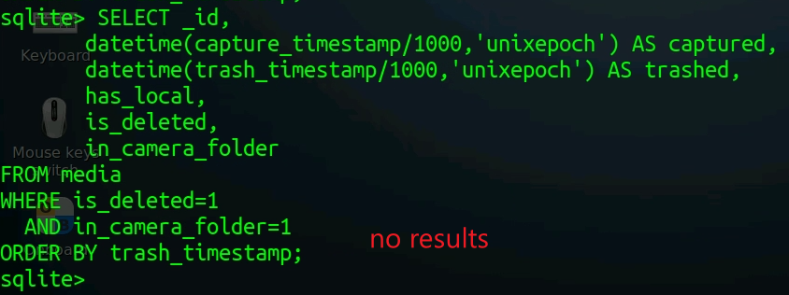
4. Example SQL to reveal deleted-but-tracked images
The results show (if there are any) that these were camera-captured photos, later deleted, and their metadata is still stored.
Notes:
SELECT _id,
datetime(capture_timestamp/1000,'unixepoch') AS captured,
datetime(trash_timestamp/1000,'unixepoch') AS trashed,
has_local,
is_deleted,
in_camera_folder
FROM media
WHERE is_deleted=1
AND in_camera_folder=1
ORDER BY trash_timestamp;

Slide 26
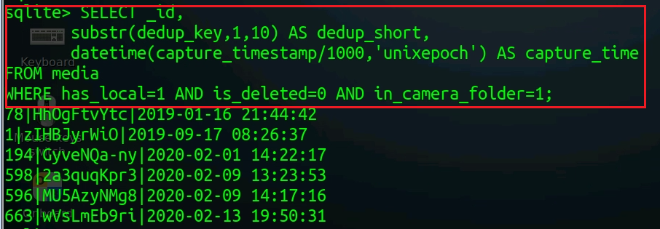




All photos or videos still present on the device and originally captured by the Pixel 3’s camera — i.e., active, undeleted evidence items.
3 files
6 rows
Why are there 6 rows but only 3 image/video files under the camera folder?
Reason | Explanation | Forensic meaning
Manual deletion via File Manager | User deleted photos directly in /DCIM/Camera, not through Google Photos. The app didn’t rescan yet, so has_local still = 1. | Indicates intentional manual deletion — Photos unaware.
Files uploaded and removed after sync | After cloud backup, Google Photos may free local space, removing full-res files but keeping metadata. | Shows cloud-only retention (has_local=1 stale, file missing).
Files are in different folders
Notes:
SELECT _id,
substr(dedup_key,1,10) AS dedup_short,
datetime(capture_timestamp/1000,'unixepoch') AS capture_time
FROM media
WHERE has_local=1 AND is_deleted=0 AND in_camera_folder=1;

Slide 27
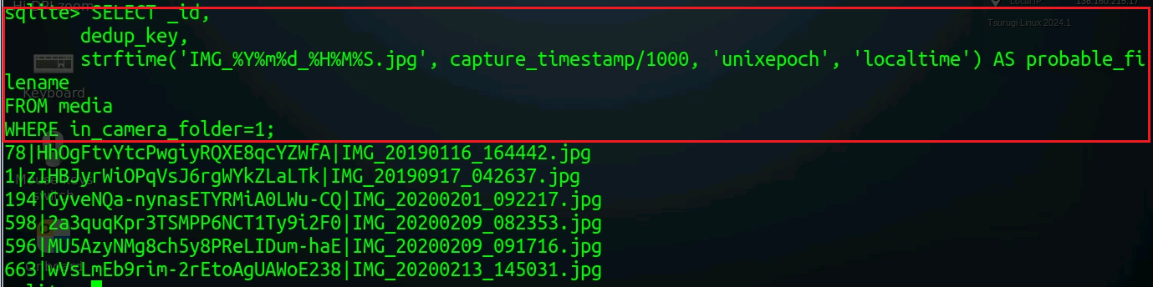
Manual filename reconstruction from timestamp
assume these are jpg
Notes:
SELECT _id,
dedup_key,
strftime('IMG_%Y%m%d_%H%M%S.jpg', capture_timestamp/1000, 'unixepoch', 'localtime') AS probable_filename
FROM media
WHERE in_camera_folder=1;

Slide 28
5. Where else deletion is recorded
Google Photos may also log or mirror the deletion in:
local_trash.db → temporary trash state, often mirrors the same _id or dedup_key
external.db (MediaStore) → entry removed from files table, or marked with media_type=0 / missing _data
Thumbnails cache → small .jpg previews may persist under /data/data/com.google.android.apps.photos/cache/
Together, these artifacts let you reconstruct a deleted file’s existence even without the photo itself.

Slide 29
6. Why this persistence exists (from app’s design)
Google Photos keeps metadata to:
Allow “Undo delete” and “Restore from Trash” actions.
Keep sync consistency with the cloud.
Track deduplication keys and user interactions.
Forensics benefits because this design means:
🔥 Even when the DCIM folder is wiped, gphotos0.db retains timestamps, hashes, and deletion logs.

Slide 30
gphotos_1.db

Slide 31
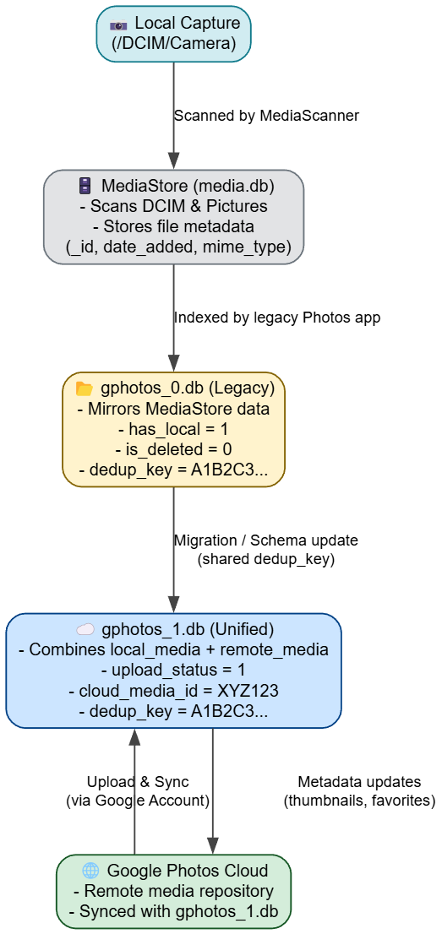
gphotos0.db and gphotos-1.db
gphotos_0.db and gphotos_1.db work independently, though they may share historical lineage and partially overlapping content.
When Google Photos switched to a new schema (around 2020–2021 with scoped storage and multi-user handling), it copied or transformed entries from gphotos_0.db → gphotos_1.db.
After migration, gphotos_0.db was frozen; it remains as a legacy artifact but isn’t updated.
New or modified media records (uploads, deletions, favorites) exist only in gphotos_1.db.
Matching dedup_key across them ties a specific photo’s local presence to its cloud upload
dedup_key is one of the most powerful evidential links in Android photo forensics.
Notes:
digraph GPhotosRelation {
rankdir=TB;
graph [splines=ortho, bgcolor="white", nodesep=0.6, ranksep=0.8];
node [shape=box, style="rounded,filled", fontname="Helvetica", fontsize=11];
edge [fontname="Helvetica", fontsize=10, arrowsize=0.9, color="#444444"];
// Nodes
capture [label="📷 Local Capture\n(Media file saved in /DCIM/Camera)", fillcolor="#d1ecf1", color="#117a8b"];
gphotos0 [label="📂 gphotos0.db\n(has_local = 1)\n(is_deleted = 0)\n(dedup_key = A1B2C3...)", fillcolor="#fff3cd", color="#856404"];
gphotos1 [label="☁️ gphotos-1.db\n(upload_status = 1)\n(cloud_media_id = XYZ123)\n(dedup_key = A1B2C3...)", fillcolor="#cce5ff", color="#004085"];
// Edges
capture -> gphotos0 [label="Indexed by Photos app"];
gphotos0 -> gphotos1 [label="Cloud sync enabled\n(shared dedup_key)"];
}

Slide 32
Aspect | gphotos0.db | gphotos-1.db
Purpose | Local metadata database for media stored on the device | Cloud-linked database for synced Google Photos content
Created when | Photos app scans device folders (e.g., DCIM/Camera, Downloads) | User enables cloud backup with a signed-in Google account
Scope | All media visible on the device (including deleted or hidden) | Media uploaded to, downloaded from, or associated with the user’s cloud library
Sync state | Tracks file’s local availability (has_local, is_deleted, in_camera_folder) | Tracks cloud state (upload_status, cloud_media_id, account_id)
Primary keys | _id, dedup_key, timestamps | dedup_key, cloud_media_id, account_id
File reference | Points to /data/media/0/DCIM/... | Points to Google cloud object (no local path)
Persistence | Remains after logout or cloud disabled | Purged or inaccessible after account unlink

Slide 33
How to know if backup is enabled?
Any photos that you take from a device with backup enabled will be saved to your Google Account.
If you edit and save a photo on your phone, the photo will look the same on Google Photos
Shared Preferences is the folder where such information gets stored.
Allow activities and applications to keep preferences.
Store user-specified configuration details, such as user-specific settings, keeping the user logged into the application

Slide 34
Why it's important to look for backup?
Backup is crucial in an investigation because:
Suspect may have deleted data related to the case, but took backup before deleting
If the system crashes, data can be recovered quickly from backup
Backup is done to save something important
Timestamps of the backup can be useful

Slide 35
Photo deletion scenario
Where you delete from | Local file | Cloud copy | Notes
File manager / MediaStore | Removed | Stays online | Only has_local → 0
Google Photos app (Backed up) | Removed | Moved to cloud Trash | Can restore for limited time
Google Photos app (Not backed up) | Removed | None | File lost
Google Photos web | Removed locally and in cloud | Moved to Trash | Syncs deletion to all devices

Slide 36
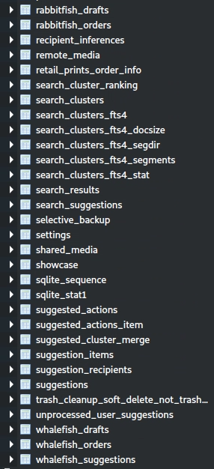
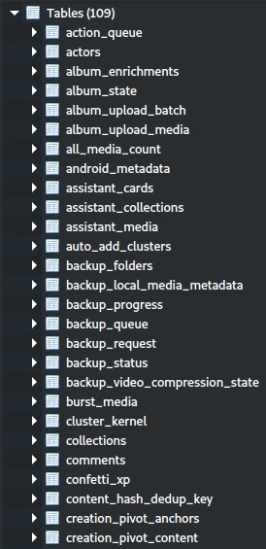
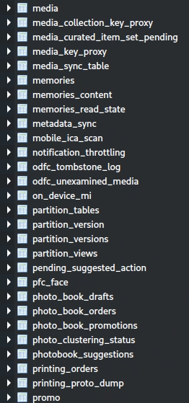
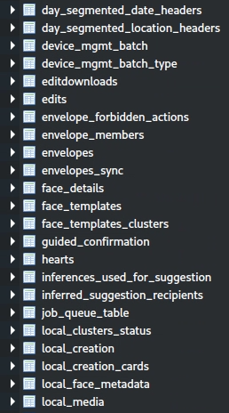
tables in gphotos-1.db
Notes:
Cmd: sqlitebrowser 'Pixel 3/data/data/com.google.android.apps.photos/databases/gphotos-1.db'

Slide 37
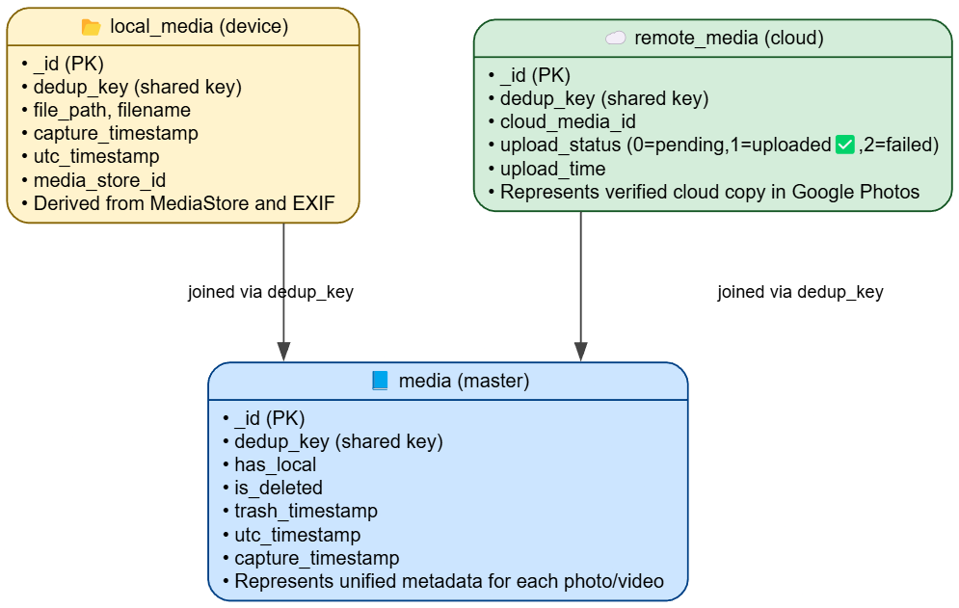
Grouping of Tables Based on Google Photos Functions -1 (media management)
Media Storage and Metadata Evidence
Stores core data about photos, videos, and their metadata,
Critical for accessing media files and their associated details.
Difference
media = master record (one row per logical photo).
local_media = device-side metadata.
remote_media = cloud-side metadata.
dedup_key links tie them together.
Notes:
digraph GPhotos1Relations {
rankdir=TB;
graph [splines=ortho, bgcolor="white", nodesep=0.9, ranksep=0.9];
node [shape=record, style="rounded,filled", fontname="Helvetica", fontsize=11];
edge [fontname="Helvetica", fontsize=10, arrowsize=0.9, color="#444444"];
// Nodes
media [label="{📘 media (master)|• _id (PK)\l• dedup_key (shared key)\l• has_local\l• is_deleted\l• trash_timestamp\l• utc_timestamp\l• capture_timestamp\l• Represents unified metadata for each photo/video\l}",
fillcolor="#cce5ff", color="#004085"];
local_media [label="{📂 local_media (device)|• _id (PK)\l• dedup_key (shared key)\l• file_path, filename\l• capture_timestamp\l• utc_timestamp\l• media_store_id\l• Derived from MediaStore and EXIF\l}",
fillcolor="#fff3cd", color="#856404"];
remote_media [label="{☁️ remote_media (cloud)|• _id (PK)\l• dedup_key (shared key)\l• cloud_media_id\l• upload_status (0=pending,1=uploaded✅,2=failed)\l• upload_time\l• Represents verified cloud copy in Google Photos\l}",
fillcolor="#d4edda", color="#155724"];
// Edges
local_media -> media [label=" joined via dedup_key", color="#444444"];
remote_media -> media [label=" joined via dedup_key", color="#444444"];
}

Slide 38
Grouping of Tables Based on Google Photos Functions – 2 (User Activity and Interaction Evidence)
user interactions with the app, such as sharing, favoriting, hiding, or editing media, revealing behavioral patterns.
action_queue, shared_media, editdownloads, edits, envelope_forbidden_actions

Slide 39
media tables
It is the core of the Google Photos database (duplicated during the transition)
Storing detailed information about photos and videos, such as file paths, IDs, timestamps (e.g., creation, modification, upload dates), and metadata (e.g., size, resolution).
Include references to cloud-synced media.
Forensic Insights:
Timestamps can establish a timeline of when media was captured or uploaded.
Metadata might include geolocation (where a photo was taken), which can place a suspect at a specific location (exiftool).
Links to deleted media might still be recoverable if not overwritten.
Example Use: An investigator could use this table to find a photo taken at a crime scene, including its geolocation and timestamp.

Slide 40
local_media tables
It stores information about media files stored locally on the device, as opposed to cloud-synced media.
Include file paths, sizes, and statuses (e.g., synced, pending upload).
Forensic Insights:
Reveals media that hasn’t been uploaded to the cloud, which might be intentionally kept offline.
Can show recently accessed or modified media, even if deleted from the app’s visible gallery.
File paths can lead investigators to the actual media files on the device.
Example Use: Finding a locally stored photo that the user didn’t upload, which might contain incriminating evidence.

Slide 41
remote_media tables
This table records every photo/video known to the user’s Google Photos account on the device
photos uploaded from this phone, downloaded from the cloud, or synced from another device.
Each row corresponds to one cloud object (not just local file).
The table effectively bridges your device → Google Photos servers.

Slide 42
backup_local_media_metadata tables
The table contains metadata for media queued for backup or already backed up
including timestamps, file sizes, and possibly EXIF data (e.g., camera details, geolocation).
Forensic Insights:
Timestamps can show when a photo was marked for backup, indicating user activity.
EXIF data can reveal where and how a photo was taken (e.g., device model, GPS coordinates).
Can help reconstruct a timeline of media management activities.
Example Use: Corroborating a suspect’s location by matching geolocation data with a known crime scene.

Slide 43
media tables

Slide 44
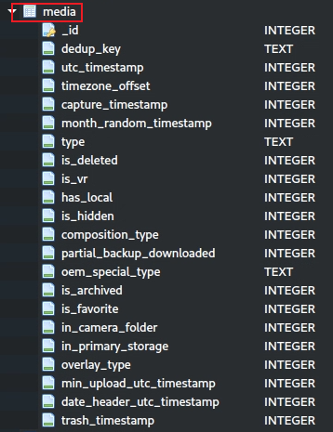
media table schema

Slide 45
Column | Meaning
_id | Primary key for the unified media item. Each entry corresponds to a photo or video known to Google Photos (either local, remote, or both).
dedup_key | A string hash used to identify duplicate media (often derived from file content, EXIF, or Google Photos’ internal ID).
utc_timestamp | The canonical UTC time Google Photos associates with the item (often equals the EXIF “date taken”).
timezone_offset | Offset in minutes or milliseconds applied to adjust UTC → local time (useful for devices in different zones).
capture_timestamp | Exact time the media was captured (from EXIF or system metadata).
month_random_timestamp | Used internally for randomizing or grouping timeline views within a month (UI optimization).
type | Media MIME type or simplified category (e.g., “image/jpeg”, “video/mp4”, “motion_photo”).
is_deleted | Flag (0/1) indicating whether the item is in the Trash or deleted state.
is_vr | Marks 360° or VR content (1 if it’s a VR photo or video).
has_local | Indicates whether the media file currently exists on the device (1 = local file present, 0 = only in cloud).
is_hidden | Hidden items (archived, excluded from main gallery).
composition_type | Integer identifying composite media (burst, panorama, motion photo, etc.).
partial_backup_downloaded | True if only part of the cloud backup is cached locally (e.g., low-res preview).
oem_special_type | OEM-specific tag (some devices label special captures like portrait or night mode).
is_archived | 1 if the user manually archived the photo (removes it from main timeline).
is_favorite | 1 if starred/liked by the user.
in_camera_folder | Indicates whether it originates from the camera roll (e.g., /DCIM/Camera/).
in_primary_storage | Whether the file is stored in the device’s primary storage volume vs. SD card.
overlay_type | Used for internal UI overlays (for example, live photos, burst indicators).
min_upload_utc_timestamp | Timestamp for the earliest upload attempt (helps track upload state).
date_header_utc_timestamp | Used for chronological grouping in the timeline header (gallery sorting).
trash_timestamp | The time the user moved the photo to Trash. Helps manage 60-day deletion policy.

Slide 46
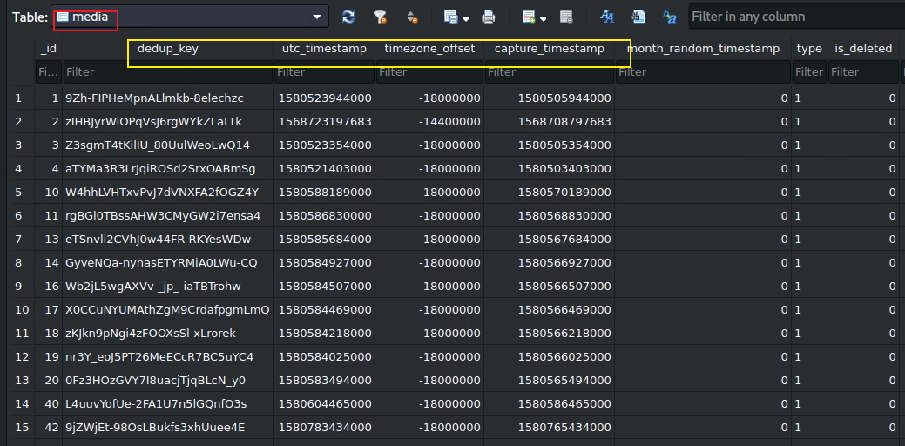

Slide 47
local_media tables
contains photos

Slide 48
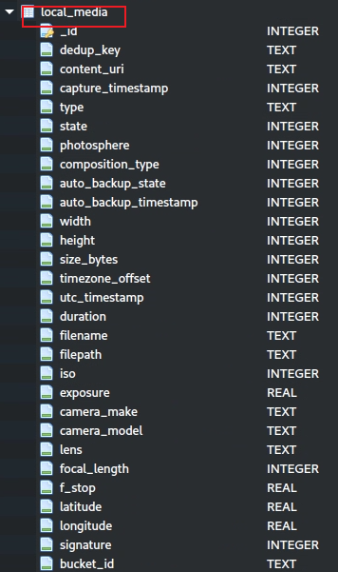
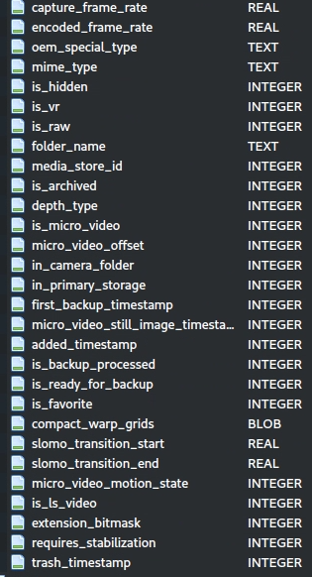
local_media table schema
Direct Access (filepath, content_uri): These columns are top-ranked because they provide direct access to the media file, which is critical for retrieving evidence.
Timestamps (capture_timestamp, utc_timestamp): Essential for establishing a timeline of when the media was created or modified.
Identifiers (dedup_key, id): Enable matching and cross-referencing media across the database, aiding in comprehensive analysis.
Behavioral Flags (is_favorite, is_hidden): Highlight media the user prioritized or hid, often pointing to significant content.
Metadata (filename, longitude, latitude): Provide context and location.

Slide 49
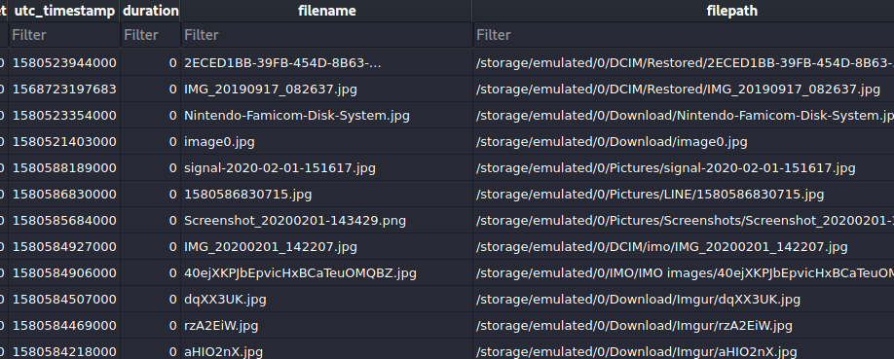
one sample picture in local_media table

Slide 50

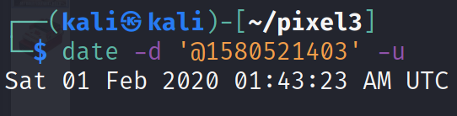
Solution (download images)
Image0.jpg
Date when image was clicked

Slide 51
remote_media table schema
Field | Meaning / Forensic value
dedup_key | Unique fingerprint (SHA-like hash) linking the same media across gphotos0.db, remote_media, and other devices.
upload_status | 1 = uploaded successfully, 0 = pending, 2 = failed. ✅ 1 is your proof of successful cloud backup.
server_creation_timestamp | Time the item was created in the Google Photos cloud (Unix ms). Correlates with upload_status = 1.
capture_timestamp / utc_timestamp | When the photo/video was originally captured.
photo_id (cloud_media_id if newer version) | Google-server object ID – used in lawful requests or API look-ups.
mime_type | Media type (e.g., image/jpeg, video/mp4).
filename | Original filename reported to the cloud.
camera_make, camera_model, focal_length, iso, exposure | EXIF-derived device and capture parameters.
latitude, longitude | GPS location of capture (if available).
is_favorite, is_archived, is_shared | User actions in the Photos app.
is_hidden, trash_timestamp | Whether moved to trash and when.

Slide 52
Scenario: Suspect denies capturing incriminating photos.
Goal: show whether
(a) such images were captured on the device,
(b) whether they were uploaded to Google Photos,
(c) when and under which account, and
(d) whether they were deleted.

Slide 53
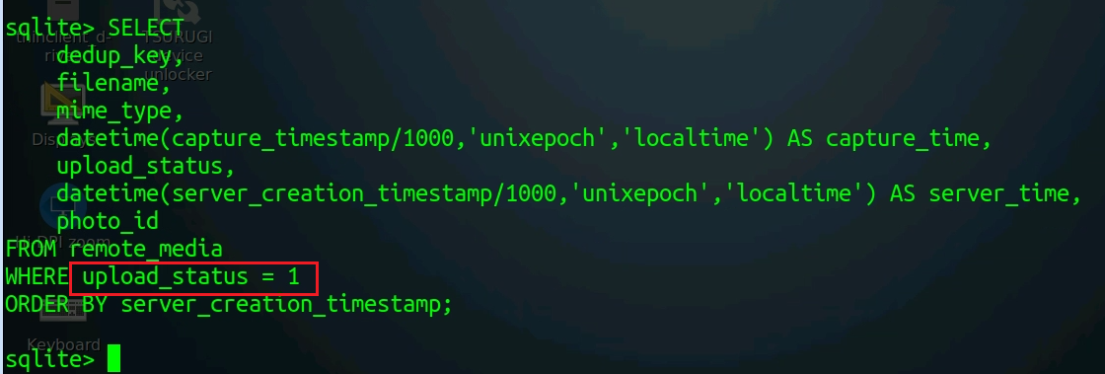
no backup
Notes:
SELECT
dedup_key,
filename,
mime_type,
datetime(capture_timestamp/1000,'unixepoch','localtime') AS capture_time,
upload_status,
datetime(server_creation_timestamp/1000,'unixepoch','localtime') AS server_time,
photo_id
FROM remote_media
WHERE upload_status = 1
ORDER BY server_creation_timestamp;

Slide 54
Shared preference

Slide 55
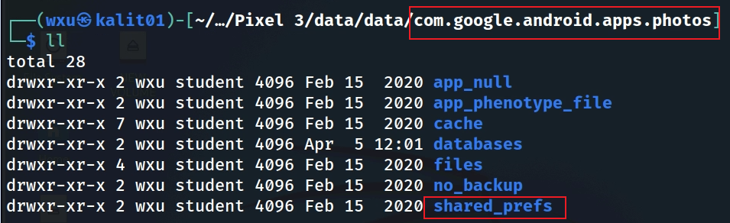
shared_prefs folder

Slide 56
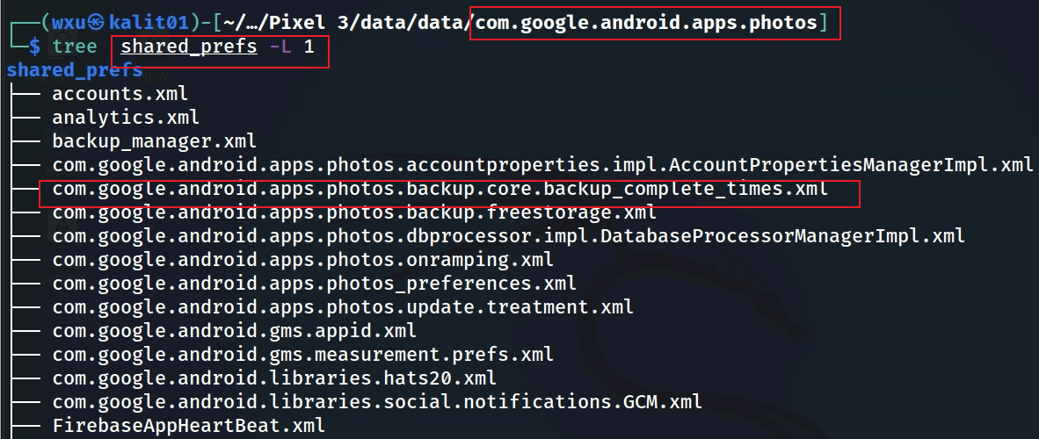
backup information in shared_prefs
Notes:
Cmd: tree 'Pixel 3/data/data/com.google.android.apps.photos/shared_prefs' -L 1

Slide 57
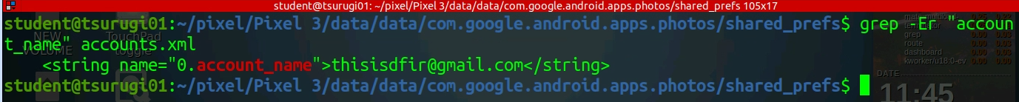
Find account name

Slide 58
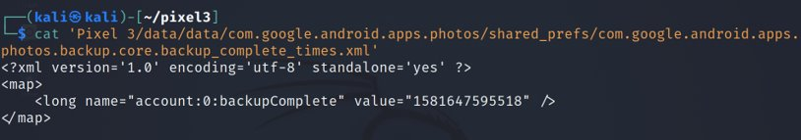
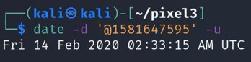
Check backup completion time
This is the time when the account backup was done, not necessarily that any media was uploaded.
Solution: timestamp
Notes:
Cmd: cat 'Pixel 3/data/data/com.google.android.apps.photos/shared_prefs/com.google.android.apps.photos.backup.core.backup_complete_times.xml'
Date cmd: date –d '@1581647595' -u

Slide 59
To summarize
Understand the application
Locate the application package
Look at the application directories
Go to the databases directory
Open gphotos-1.db
Explore local_media table
Go to the shared prefs folder
Find the file that contains backup information

